Slide 1
Assignment 1: Damped Wave Simulation with OpenMP
Simulation parallelized on HPC@PoliTO (partitions: edu_skylake, edu_sapphire)
Finding: the ceiling is I/O, synchronization and NUMA placement — not the stencil

Slide 2
A three-matrix stencil, parallelized once outside the time loop
Numerical scheme
Central differences on a regular Δx, Δy, Δt grid
u_past, u, u_fut hold t−1, t and t+1
Zero everywhere except one impulse at the centre
Pointer rotation replaces deep-copying matrices
OpenMP structure
One parallel region opened before the time loop
collapse(2) fuses i and j into one M×M space
Each thread owns a disjoint set of coordinates
The writing thread also rotates, so the swap is safe
Per-timestep sequence
stencil update
(omp for, collapse(2))
scale into
pixel buffer
one fwrite
(omp single)
rotate
u_past / u / u_fut
Parameters throughout: impulse −49 at the grid centre, propagation speed c = 0.33, damping γ = 0.187.

Slide 3
Profiling pointed at the barrier, not the stencil
VTune Hotspots analysis at M=1000 on 32 threads: 79.4% of CPU time in gomp_team_barrier_wait_end, 9.7% in fwrite, 2.2% in the stencil.
1. Buffered frame output
Per-pixel fwrite replaced by one in-memory buffer, filled in parallel and flushed with a single call per frame.
2. Loop fusion
Stencil and buffer-fill span the same (i,j) range, so they were merged into one omp for, removing the added barrier.
3. Parallel init and (guided) schedule
Initialization parallelized with the same stencil's schedule (guided)
57.5%
barrier wait, from 79.4%
15.7%
stencil, from 2.2%
<0.3%
fwrite, from 9.7%
Threading analysis still reported 23% CPU utilization — 7.36 effective threads out of 32 — so at M=1000 the workload was too small for the team size. schedule(guided) was retained here because it absorbs the imbalance of the single-threaded write.

Slide 4
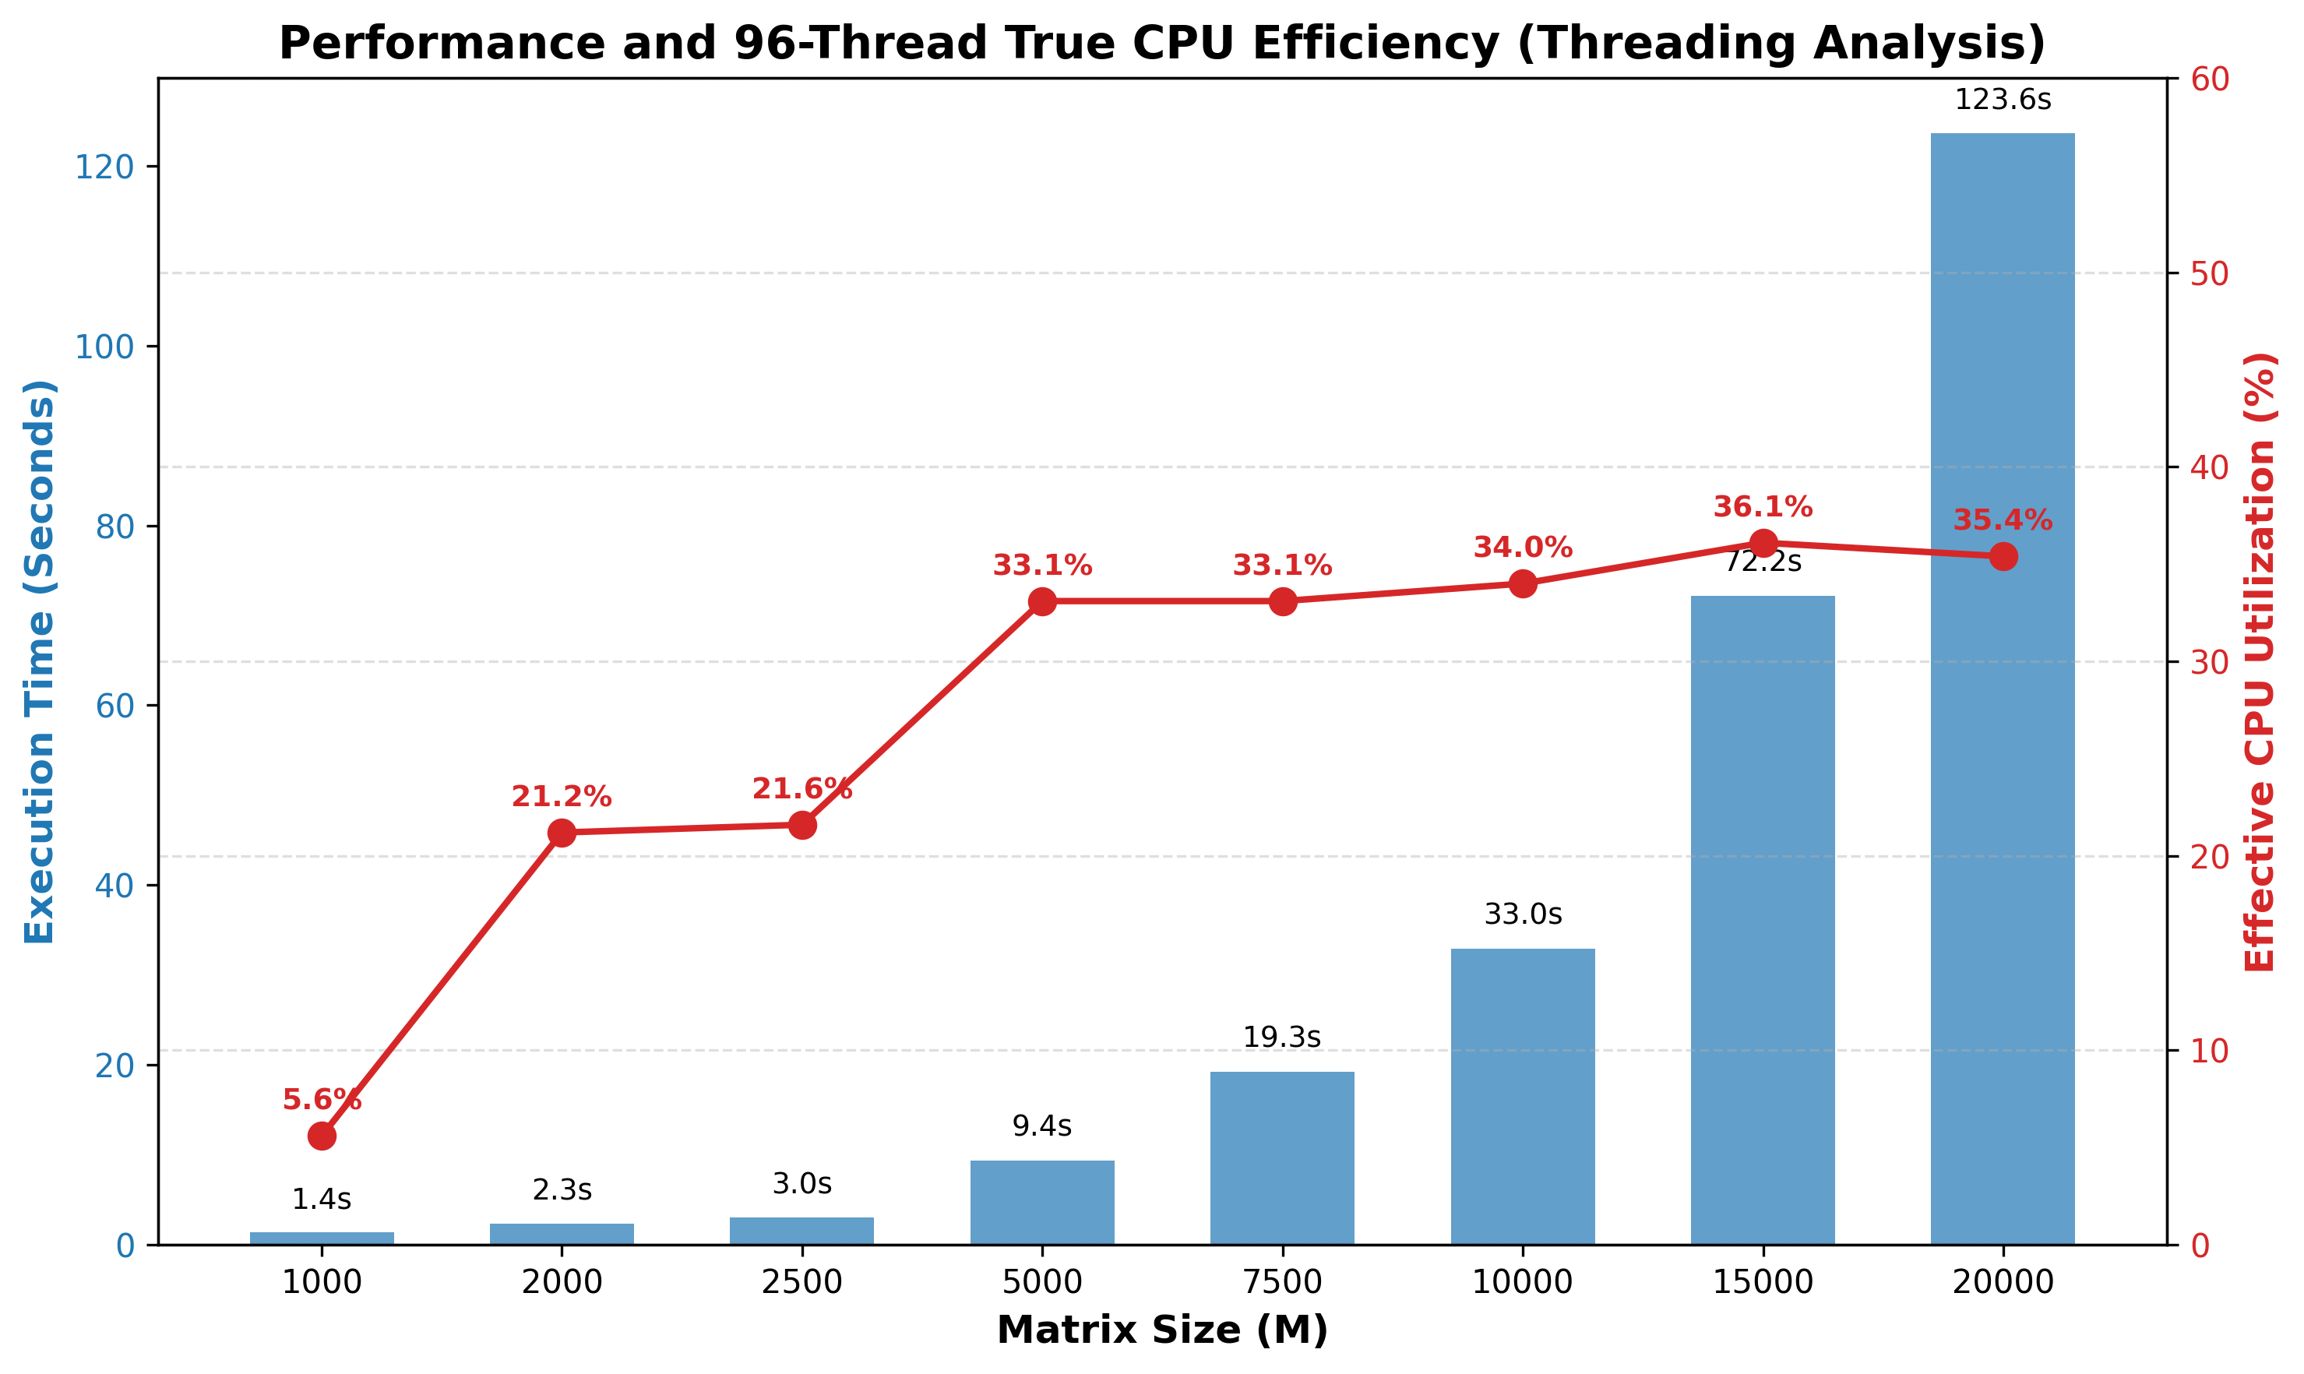
CPU utilization climbs to 36% and stops there
Execution time and effective CPU utilization across grid size M, 96 threads on edu_sapphire. Below M=2500 the threads starve; M=10000→20000 costs 3.74× against an ideal 4×.

Slide 5
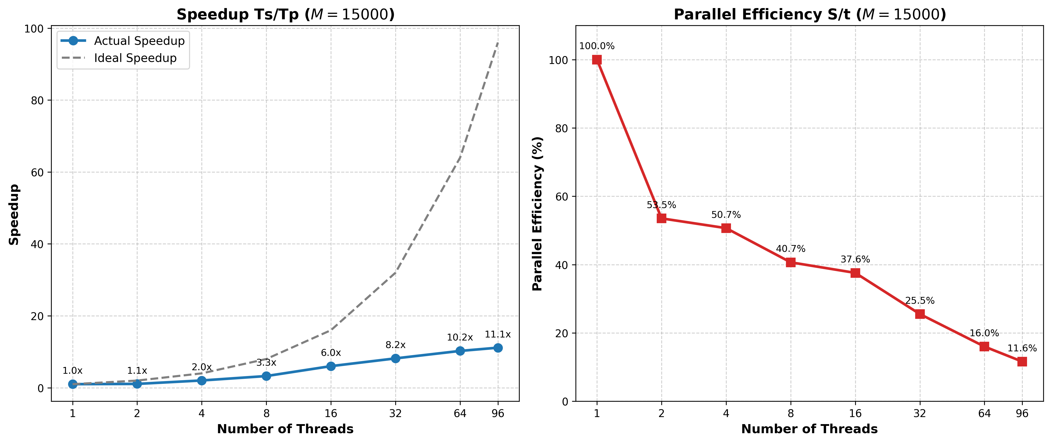
At M=15000, 96 threads return only 11.1× speedup
Full pipeline with I/O. Up to 32 threads every thread owns a physical core and the loss is barrier cost; past 48 cores the rest are SMT siblings, and efficiency ends at 11.6%.

Slide 6
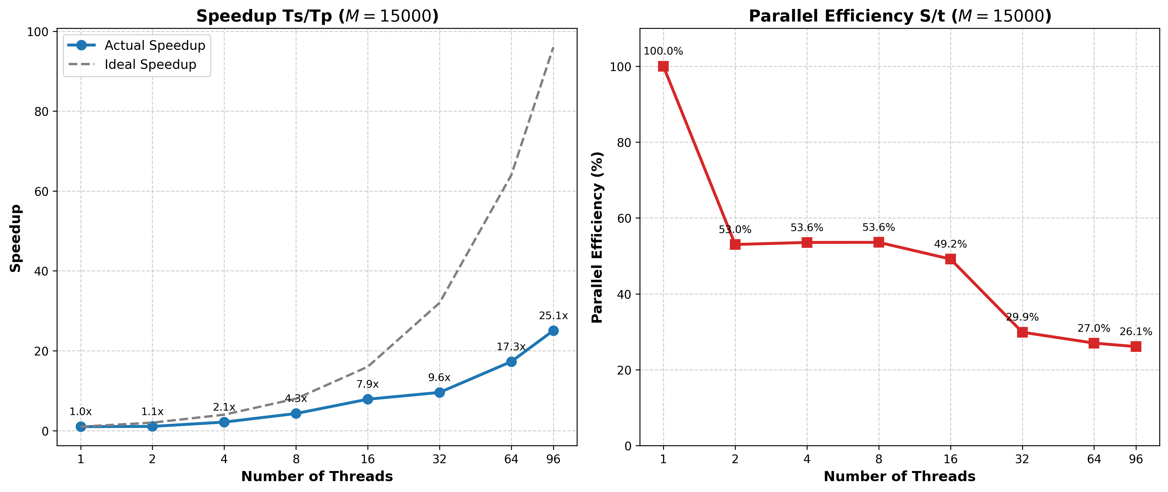
Disabling I/O more than doubles speedup, to 25.1×
Same sweep, frame writes removed. At 96 threads speedup goes 11.1× → 25.1× and efficiency 11.6% → 26.1%: the overhead was the writes and their barriers, not the stencil.

Slide 7
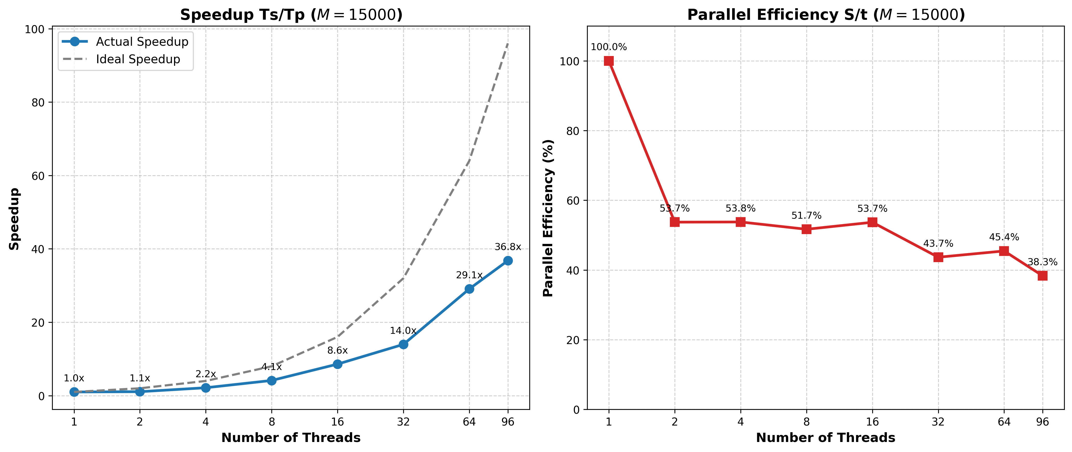
NUMA-aligned static scheduling takes it to 36.8×
I/O disabled, schedule(static) in both init and stencil, so each thread keeps the rows it first touched. Efficiency 43.7% vs. 29.9% at P=32, 45.4% vs. 27.0% at P=64.

Slide 8

Colorized Wave Simulation on GPU
Assignment 3 — MPI + OpenMP + CUDA
Profiled on HPC@PoliTO (Legion), edu_a40 and edu_v100
Finding: the bottleneck is file I/O, not compute

Slide 9
Three independent scenarios, one shared GPU
Per-rank pipeline
3 MPI ranks, one scenario each
OpenMP 5-point Laplacian stencil
CUDA kernel maps each value to RGB
Per-frame adaptive colour scale
ASCII P3 PPM frame written each step
Cluster: HPC@PoliTO (Legion)
edu_a40 — 2x24 cores + SMT, 4x A40
edu_v100 — 32 cores, 4x V100
Job requests --gres=gpu:1
All three ranks share one GPU
Nsight Compute blocked: ERR_NVGPUCTRPERM
Per-frame output path
compute_next
(OpenMP)
H2D copy
colorize
kernel
D2H copy
ASCII format
disk write
(fwrite)
These last two carry ~99% of the frame cost

Slide 10
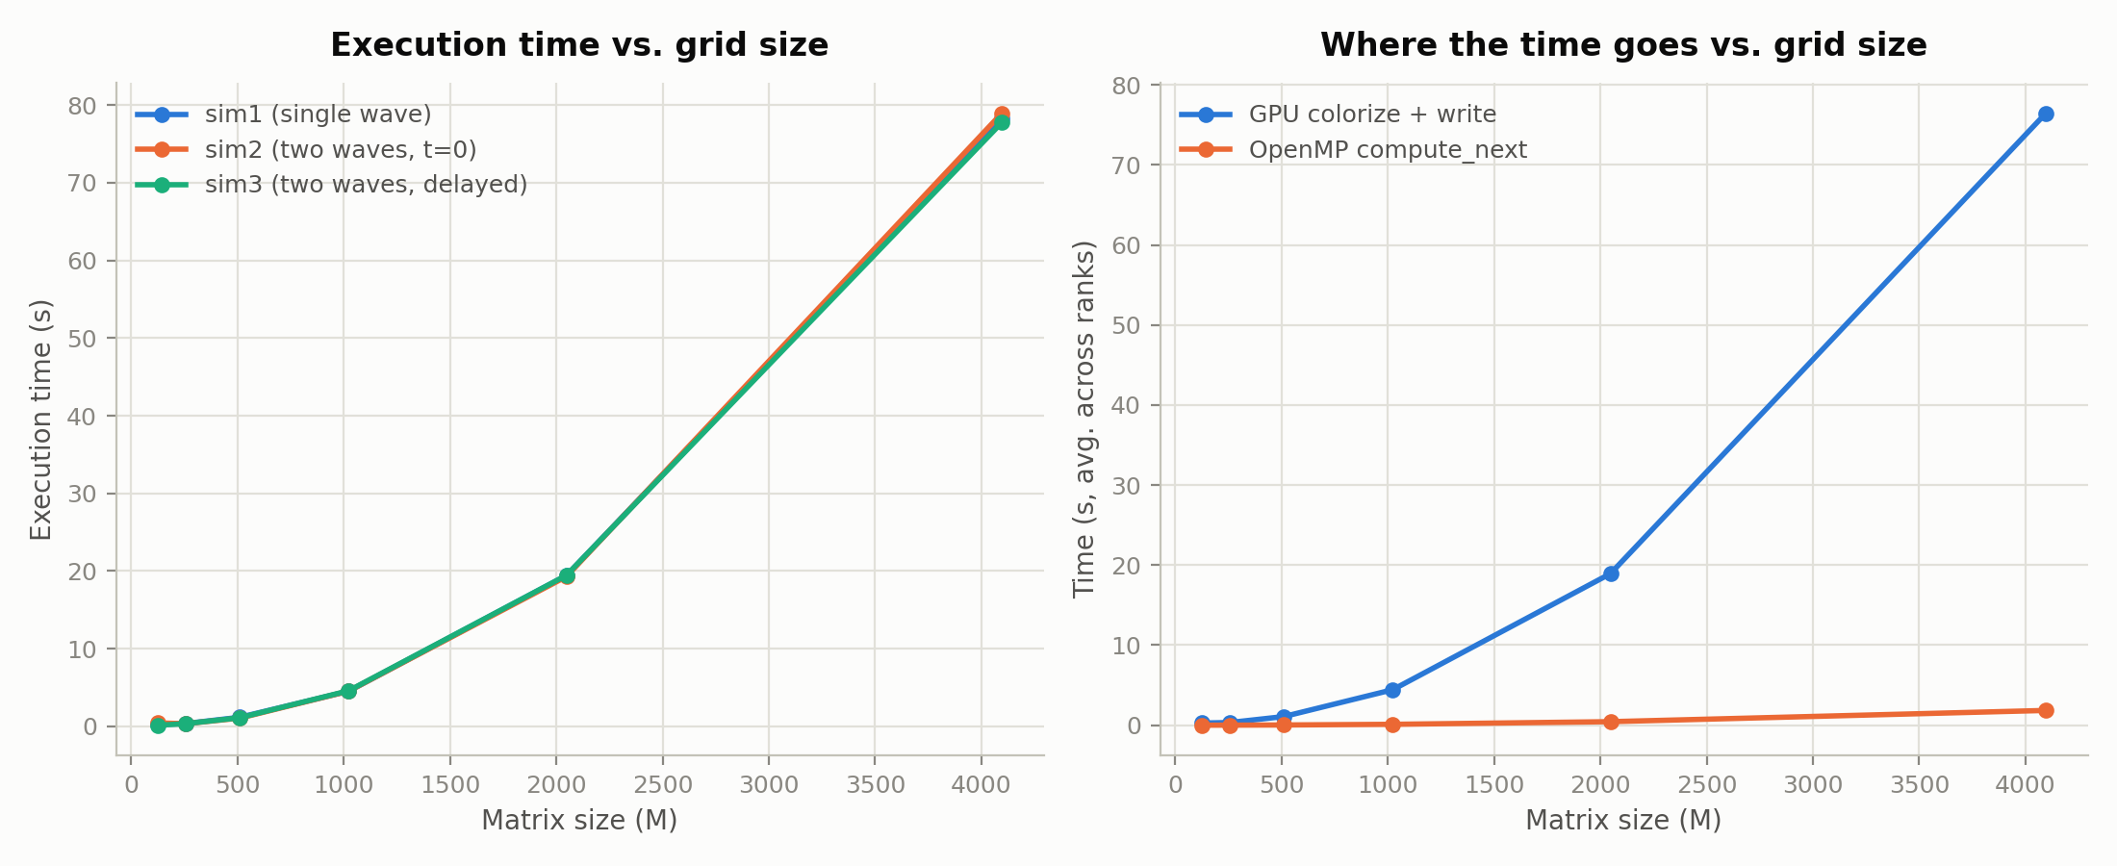
Near-ideal O(M²) scaling — and GPU colorize+write dominates throughout
128 → 256 costs only 2.1×, 2048 → 4096 costs 4.1× (ideal quadratic). At M=4096, GPU colorize+write is ~97.6% of total time; compute_next ~2.4%.
Sweep capped at M=4096: an ASCII PPM frame is already ~100–130MB there, so M=15000 would mean multi-gigabyte frames across 50 steps and 3 ranks.

Slide 11
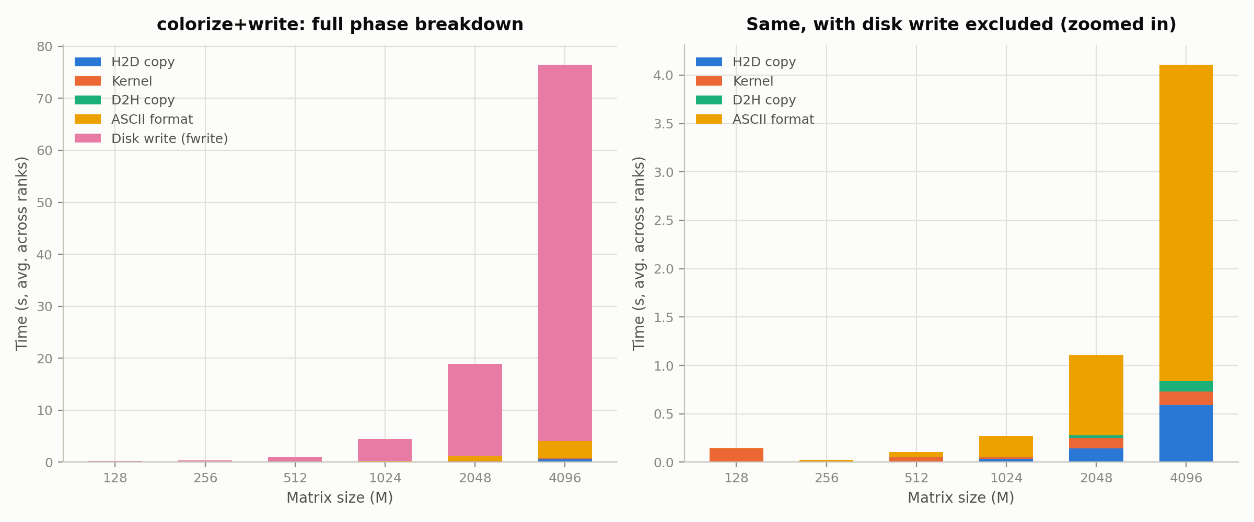
The disk write is 94.6% of the frame cost
At M=4096: write ~94.6%, ASCII format ~4.3%, H2D+kernel+D2H ~1% combined — so parallelizing the ASCII formatting was measured, then rejected.

Slide 12
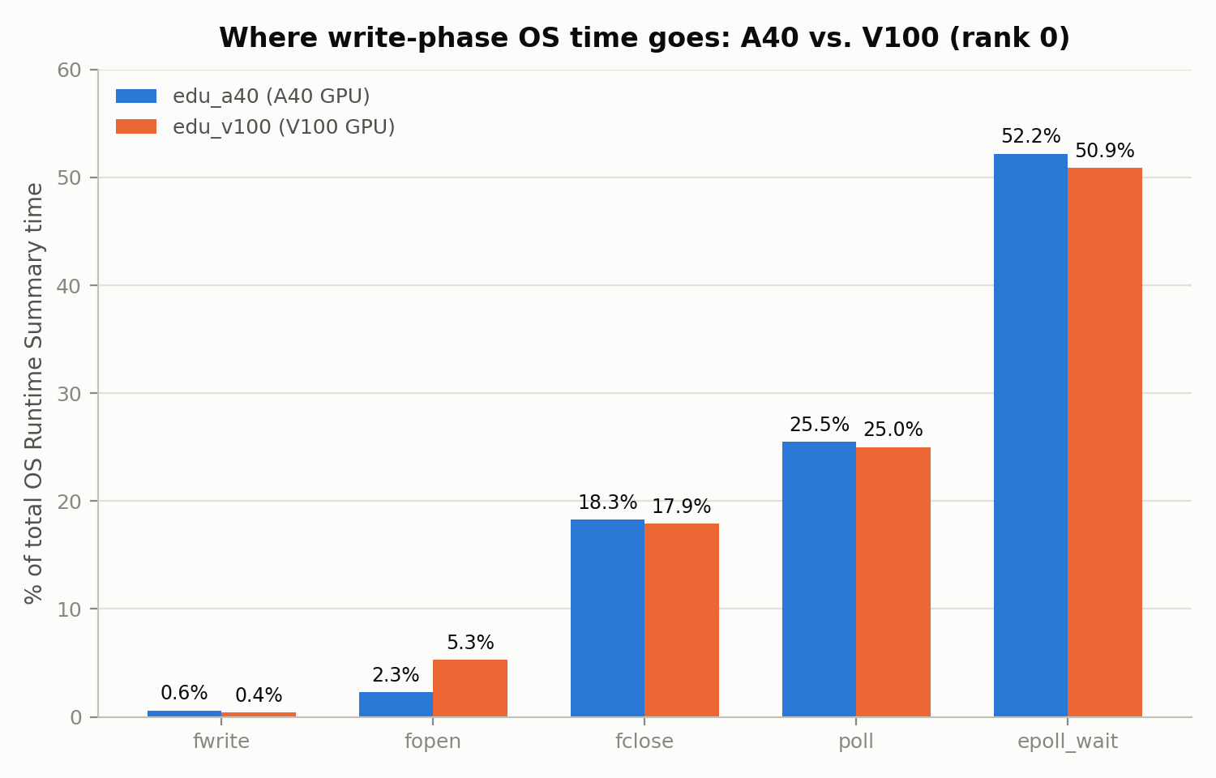
It isn't fwrite — it's fclose, on both GPU generations
Nsight Systems OS Runtime Summary, rank 0. fclose ~18% vs. fwrite ~0.6% — roughly 30× the call it follows. Profile is near-identical on A40 and V100, so the bottleneck is I/O and synchronization, not GPU hardware.
18.3%
fclose
0.6%
fwrite
epoll_wait ~52% + poll ~25% most plausibly reflect ranks idling on MPI progress — reported without claiming a precise causal link.

Slide 13
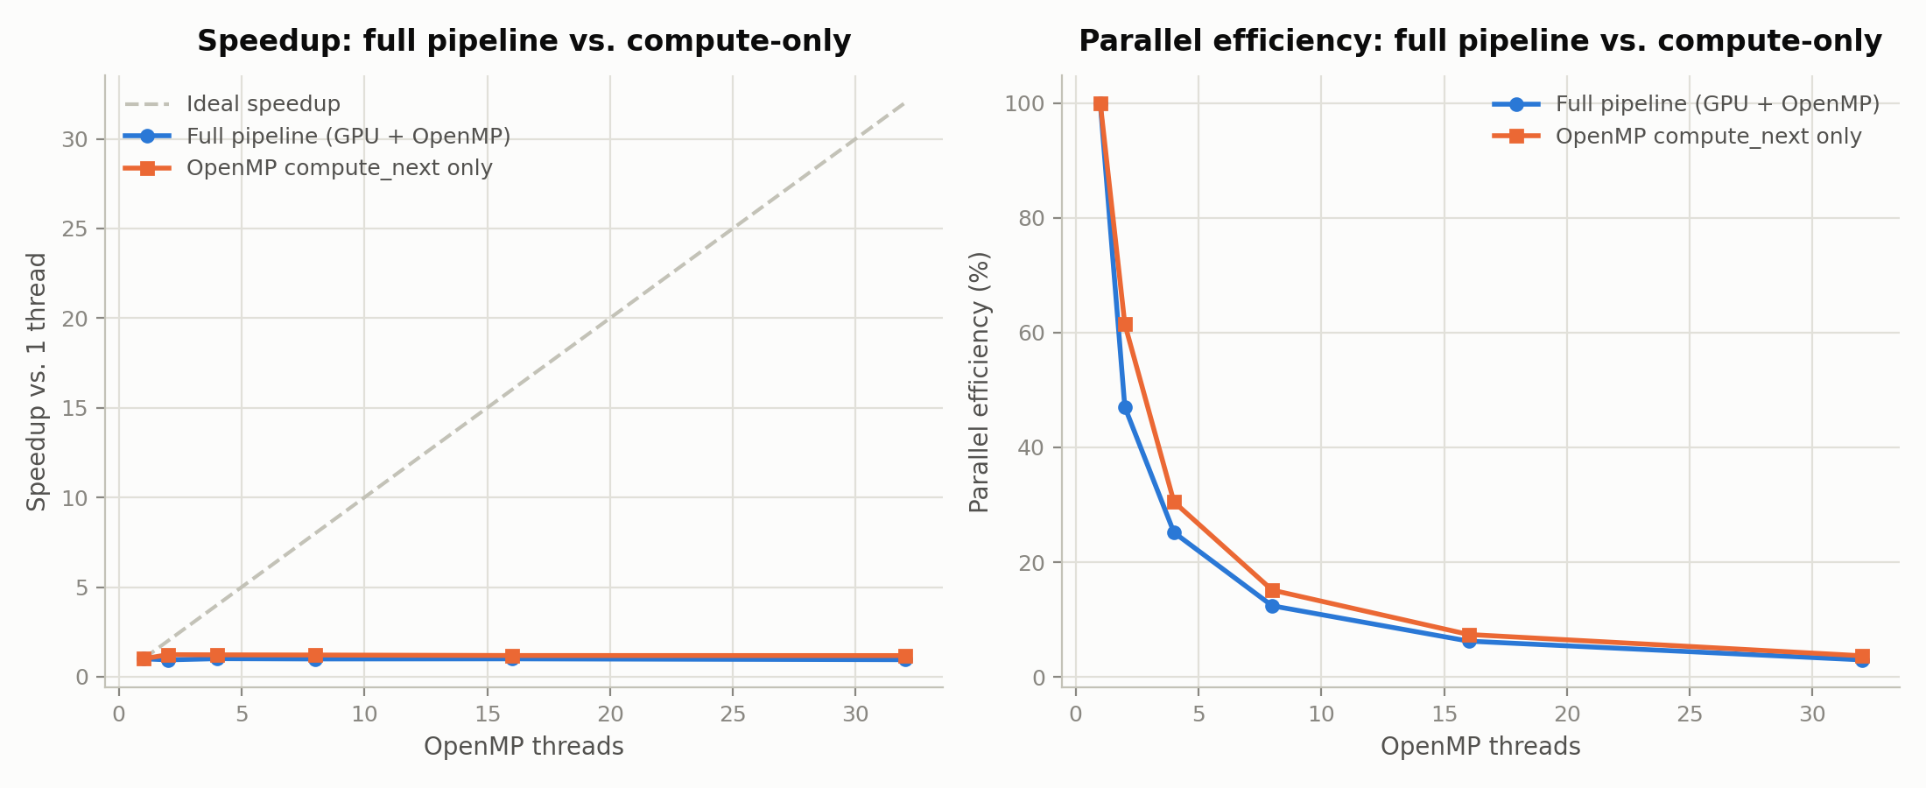
Threads buy nothing: flat from 1 to 32 threads
M=4096: both curves flat, never above ~1.2×; compute-only plateaus by 2 threads. Consistent with a bandwidth-bound stencil and with per-call OpenMP fork/join overhead — we did not isolate which dominates.

Slide 14
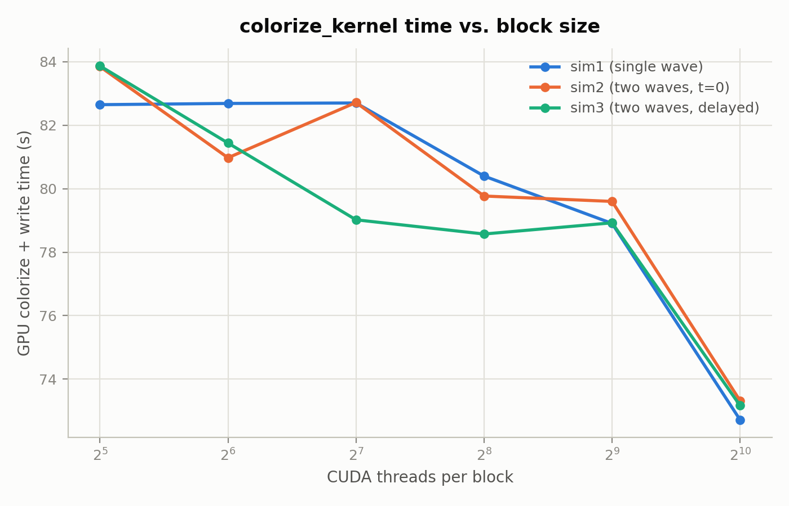
Bigger CUDA blocks win: ~12% from 32 to 1024 threads
M=4096, GPU colorize + write time.
Time falls roughly monotonically with block size: ~83s at 32 threads/block down to ~73s at 1024, with a minor plateau between 128 and 512.
Not independently confirmed: a noisier earlier sweep at M=1024 trended the other way at the high end, and Nsight Compute is blocked, so there is no occupancy-level explanation.
~83s
32 threads/block
~73s
1024 threads/block

Slide 15
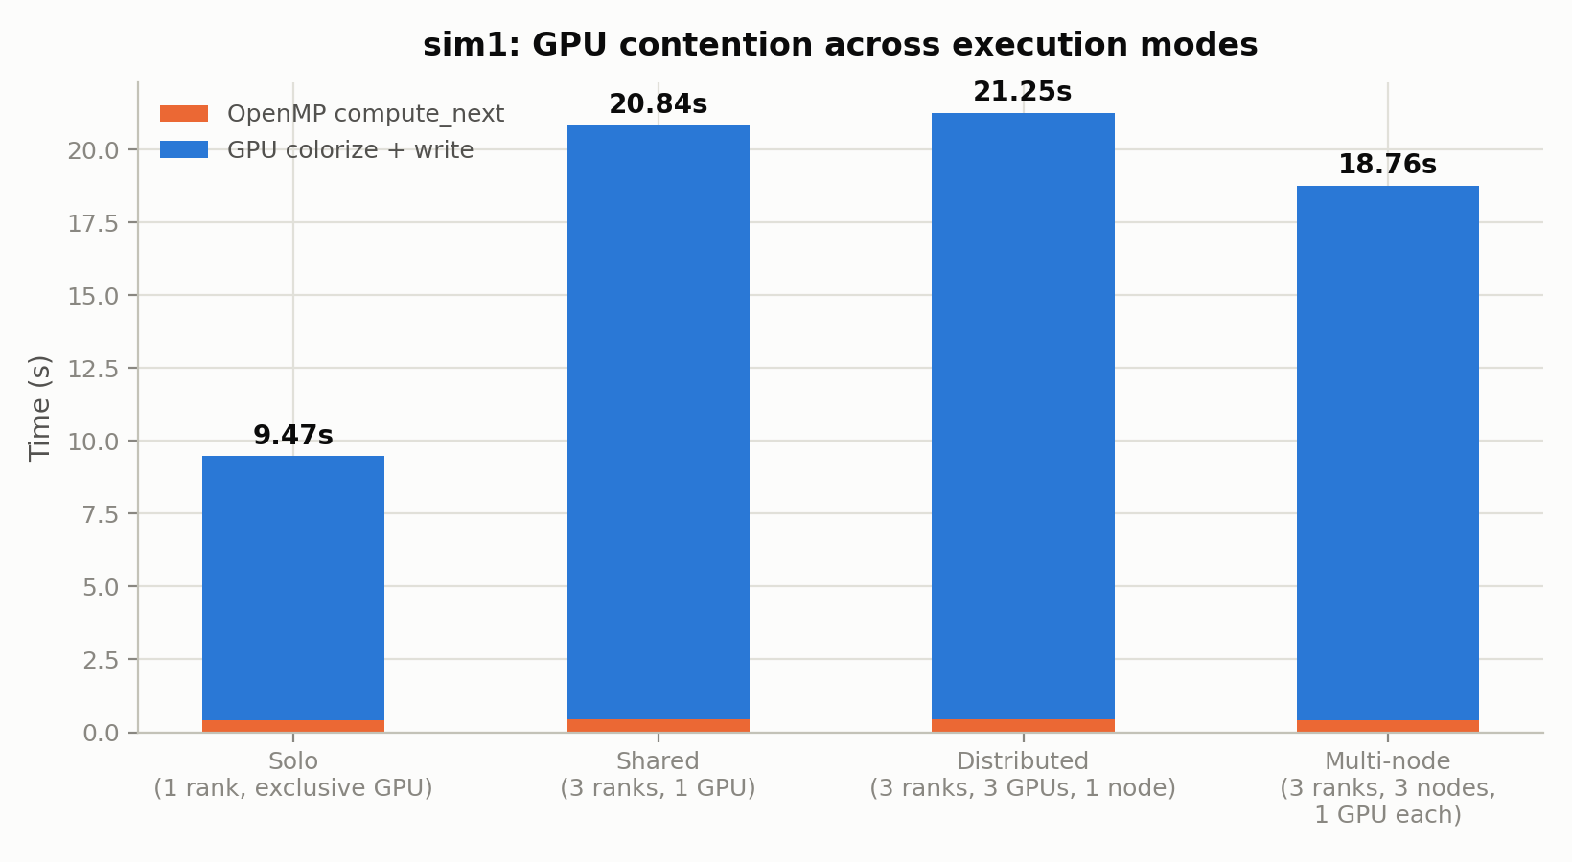
Sharing the GPU is free; sharing the filesystem is not
M=2048, 50 steps, 4 threads — sim1's workload isolated in each mode.
Dedicating a GPU per rank changes nothing: distributed (21.25s) is ~2% slower than shared (20.84s), within noise. Solo is ~50% faster because it is the only mode with a single writer. Multi-node (18.76s) removes host-local contention but still writes to the same shared filesystem.
9.47s
solo, one writer
20.84s
3 concurrent writers

Slide 16
Measure first, then optimize
I/O dominates. Colorization kernel ~1% of frame time, compute_next ~2% — the cost is per-frame file I/O, concentrated at fclose.
Confirmed across hardware. The OS-runtime profile is near-identical on A40 and V100, so it is not GPU-specific.
ASCII formatting: rejected. At ~4% of color_time, parallelizing it could not repay the added complexity.
Adaptive colour scale: adopted. Raw pixel data showed a fixed scale goes pale almost immediately.
Contention is filesystem, not GPU. Four execution modes settled it by measurement, not by spec sheet.
Every optimization decision here was made after measuring — none assumed from the physics or the spec sheet.

